Slide 1
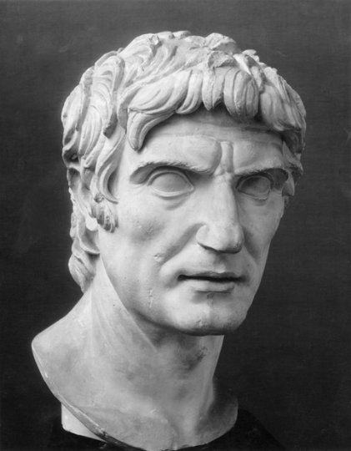
Introduction to Sulla
GOAL/S: Describe the historical context of Sulla
Week 1, Lesson 1

Slide 2
Unit 3 – Societies and Change
Term/Week | Topic/Content | Assessments
T1 - 1 | Roman Society Overview
T1 - 2 - 3 | Roman Soc/Pol/Eco/Religion/Cul
T1 – 4 - 6 | Tiberius and Gaius Gracchus (133 – 121 BCE) | Essay (Week 6 – 10%)
T1 – 7 - 9 | Gaius Marius (133 – 87 BCE) | Source Analysis (Week 9 – 10%)
T2 – 1 - 2 | Sulla (90 – 78 BCE)
T2 – 3 – 5 | EST | EST (Week 4 – 5 – 15%)
T2 – 5 - 6 | Pompey to 66 BCE | Historical Inquiry (Week 5 – 6 – 10%)
T2 - 7 | EXAMS

Slide 3
Lucius Cornelius Sulla, a prominent figure in the late Roman Republic, is best known for: - Leading the optimates faction against the populares faction, particularly in conflicts with Gaius Marius. - Achieving military success in various campaigns, including the Social War and the First Mithridatic War. - Assuming dictatorial powers in 82 BCE to restore order, implementing significant reforms and conducting proscriptions. - Implementing constitutional reforms aimed at strengthening the power of the Senate and reducing the influence of popular assemblies. - Retiring voluntarily from power, setting a precedent for the relinquishment of dictatorial authority. His actions and reforms had a lasting impact on Roman politics, setting the stage for the eventual transition from the Republic to the Empire.

Slide 4
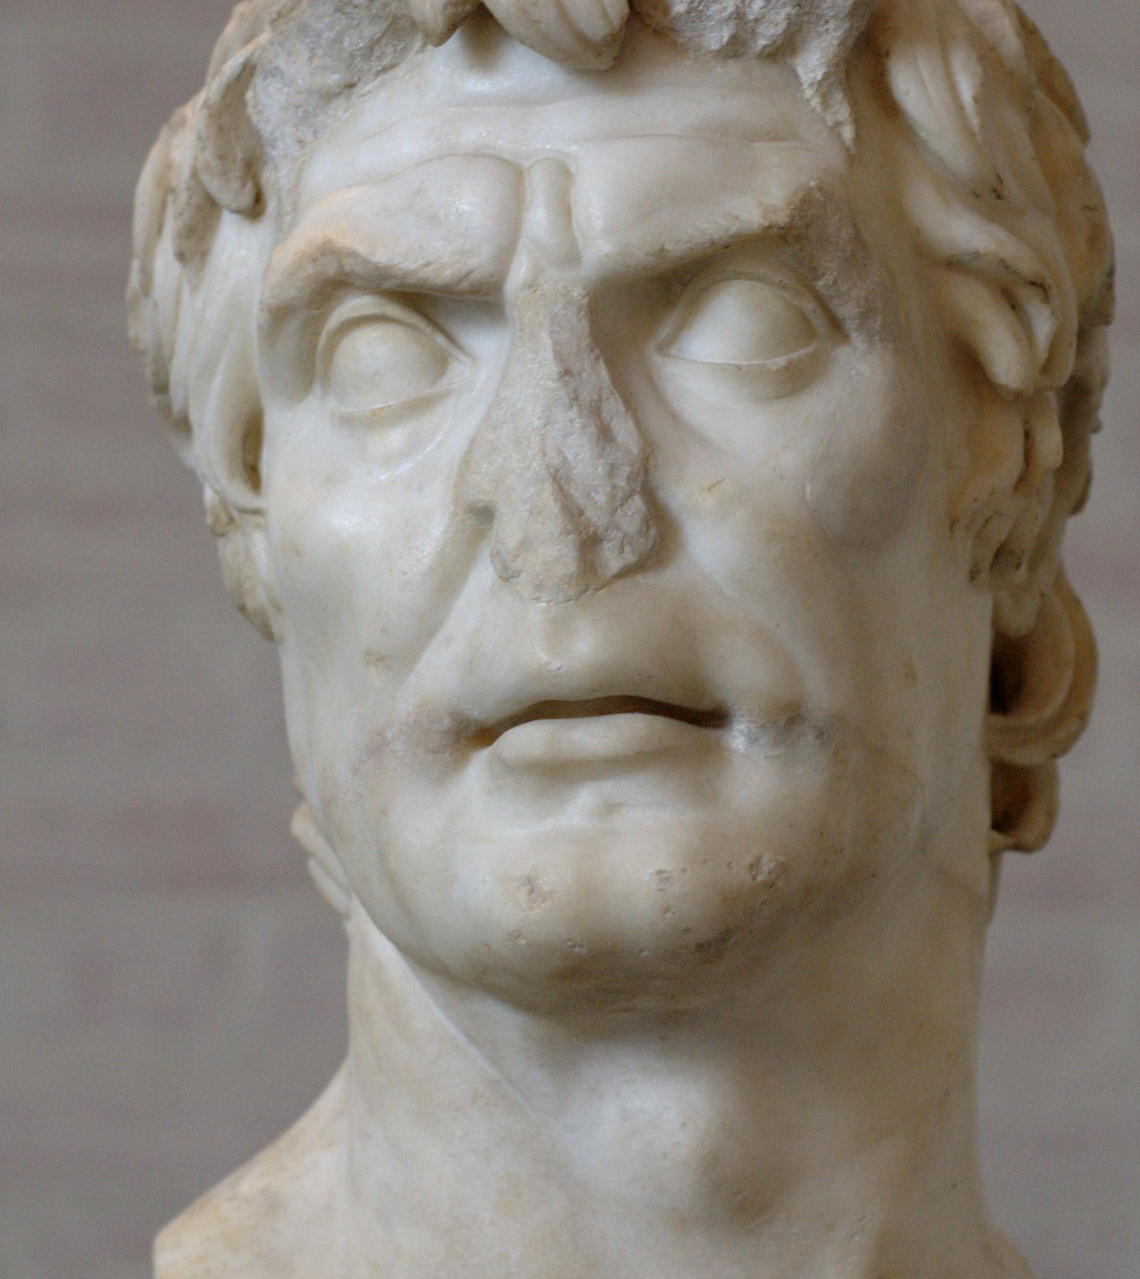
Sulla – Early Life
Lucius Cornelius Sulla Felix
Born: c. 138 BCE
Died: 78 BCE
His father was Lucius Cornelius Sulla.
He came from the Cornelius clan (an old, leading family, but relatively poor).
He had a good education, and developed a lifelong love of Greek and Roman literature.
He possessed a driving political ambition.
He was conservative at heart – an optimate.

Slide 5
Sulla – Early Life
Born into a patrician family in Rome.
Despite its respectable name, his family was quite poor.
Sulla had always had an interest in a political life but had never had the means to pursue it.
His fortunes changed when both his stepmother and lover died when he was a young man. Both women left him considerable sums of money.
This allowed Sulla to invest in a political career.
In 107 BCE, he won election as a quaestor for the first time.
In this capacity, he was picked to serve as one of Gaius Marius' lieutenants in the war against Jugurtha in North Africa.
Notes:
QUAESTOR - (in ancient Rome) any of a number of officials who had charge of public revenue and expenditure

Slide 6
ACTIVITY - Timeline
In your book, create a timeline of the key events in the life of Sulla
You can use this as a reference point (and add to it) throughout the next two weeks

Slide 7
Sulla – Key Events

Slide 8
TEACHER ONLY
138 BC: Lucius Cornelius Sulla is born in Rome, Italy.
107 BC: Sulla serves under Gaius Marius in the Jugurthine War against King Jugurtha of Numidia.
104 BC: Sulla serves as quaestor in the Roman province of Asia.
91 BC: Sulla serves as legate under Marius in the Social War.
88 BC: Sulla marches on Rome with his legions, starting the First Mithridatic War. He declares himself dictator, initiating the Sullan reforms.
87 BC: Sulla decisively defeats Gaius Marius in the Battle of Sacriportus.
86 BC: Sulla secures victory against Marius' supporters at the Battle of Chaeronea.
83 BC: Sulla emerges victorious in the Second Mithridatic War, culminating in the Battle of Orchomenus.
82 BC: Sulla returns to Rome and proscribes many of his enemies, beginning the Sullan dictatorship.
81 BC: Sulla resigns as dictator and is appointed consul for the second time.
79 BC: Sulla retires from public life and dies peacefully in his villa near Puteoli (modern Pozzuoli), Italy.

Slide 9
ACTIVITY – Marius Vs. Sulla
The relationship between Marius and Sulla was initially one of military cooperation followed by bitter rivalry, marked by political manoeuvring and eventually erupting into open conflict for control of Rome.
INSTRUCTIONS:
Create a TABLE in your book
As a class, we will use information to create an initial comparison between these two leaders which will set the stage for what's to come
Use a full page, and the information sheet provided

Slide 10
Marius | Sulla

Slide 11
Extension:
The Life of Sulla: Rome’s first Dictator for Life
https://www.youtube.com/watch?v=DqPR9JYYowk

